Slide 1
Predict Accident Severity Using U.K. Traffic Data: A PySpark Approach
Team 10
Kuo-Jui Ho, Erle Lei, Chenhui Li, Yanyan Deng
Notes:
1

Slide 2
Problem Statement
In each year, many vehicles are involved in accidents that are responsible for millions of deaths and injuries. Globally, about 1.35 million people are killed in vehicle crashes and approximately 50 million more are injured. A research from NCSA shows that road accident is becoming the third most serious cause of death in the world.
We aim to:
Draw a traffic accident symbol map.
Perform statistical analysis on the attributes that affect traffic accidents to provide traffic safety recommendations.
Use functions such as time, weather conditions and road types to predict the severity of traffic accident.
Notes:
NCSA = national center for statistics and analysis

Slide 3
Data Description
1.6 Million UK Traffic Accidents - UK Department of Transport- https://www.kaggle.com/daveianhickey/2000-16-traffic-flow-england-scotland-wales
33 columns * 1,504,153 accidents
Covers all traffic accidents from 2005 to 2014, but 2008 is missing.
Target variable: Accident_Severity (1=Fatal, 2=Serious,3=Slight)
Features: Location, Time, Speed Limit, Junction, Weather, Light, etc.
Unbalance data Distribution (more 3, than 2 & 1)
Notes:
The raw dataset is larger and available from UK Department of Transport website.

Slide 4
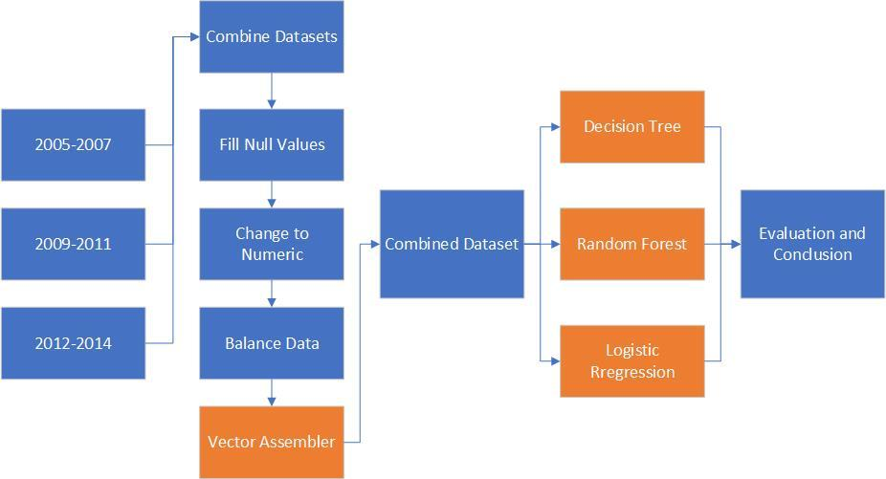
System
Design
Notes:
The raw dataset is larger and available from UK Department of Transport website.

Slide 5
Preprocessing
Pandas Approaches
Combined three datasets by using “concat”
Deleted useless variables
Filled null values by using the most frequent term or mean value
Dealt with imbalanced data using oversampling tool “SMOTE”
PySpark Approach
Vector Assembler
Notes:
1

Slide 6
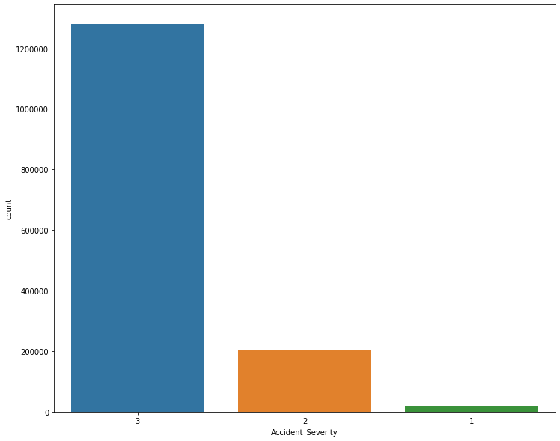
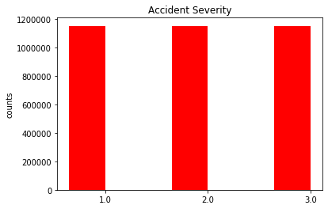
The Data After Preprocessing
22 original features + 1 target variable + 1 vectorized feature variable

Slide 7
Algorithm Development
Steps:
Split Data: 70% training and 30% testing;
Input label (target) and features using the vectorized variable;
Use multiclass classification evaluator in PySpark package.
Challenges:
Out of memory and losing connection to Spark
Limited choices of classification model
Notes:
The raw dataset is larger and available from UK Department of Transport website.

Slide 8
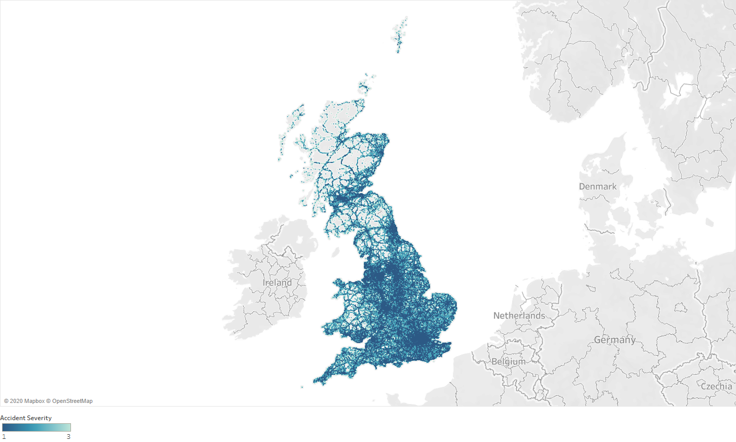
Results and Evaluation
Notes:
The raw dataset is larger and available from UK Department of Transport website.

Slide 9
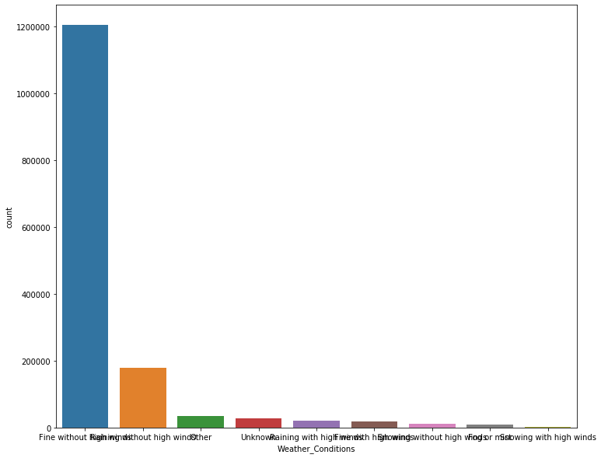
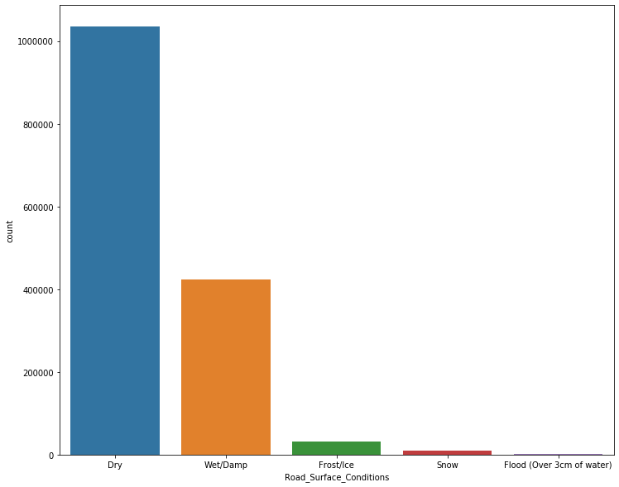
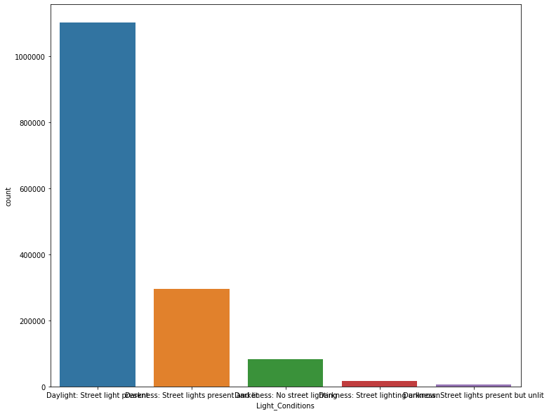
Results and Evaluation
Road surface condition
weather
Lighting condition
Notes:
The raw dataset is larger and available from UK Department of Transport website.

Slide 10
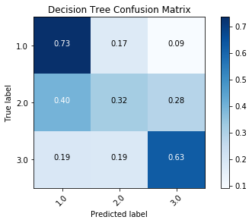
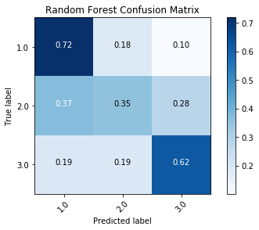
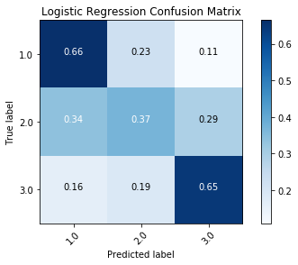
Results and Evaluation
Notes:
The raw dataset is larger and available from UK Department of Transport website.

Slide 11
Results and Evaluation
Model | Accuracy | F1 Score
Decision Tree | 0.559817952 | 0.546219197
Random Forest | 0.564171365 | 0.553867767
Logistic Regression | 0.560971915 | 0.553824775

Slide 12
Conclusion and Lessons Learned
Urban area tends to occur more fatal accidents.
Logistic regression model performed generally well.
Decision Tree predicted the severity of accidents better.
Adding more features for future study and improvement.
Some limitations.
Notes:
The raw dataset is larger and available from UK Department of Transport website.

Slide 13
Reference
https://www.researchgate.net/publication/321462497_Classification_of_Traffic_Accident_Prediction_Models_A_Review_Paper
https://www.kaggle.com/daveianhickey/2000-16-traffic-flow-england-scotland-wales
https://www.gov.uk/government/organisations/department-for-transport

Slide 14
Thanks!

